Slide 1
Analog Circuits
Module-V
COMAPRATORS & WAVEFORM GENERATORS

Slide 2
UNIT-IV
COMPARATORS AND WAVEFORM GENERATORS
Comparator – zero crossing detector, schmitt trigger, free-running, one-shot Multivibrators, sine wave generators- Barkhausen Criterion ,phase-shift, wein-bridge oscillators, Square/Triangular, saw-tooth wave Function Generator

Slide 3
COMPARATORS
1

Slide 4
COMPARATORS
An op-amp amplifier in the open loop configuration operates in a non-linear manner
There are a number of applications of op-amp in this mode such as comparators, detectors, limiters.
Comparators is a circuit which compares a signal voltage applied at one input of an op-amp with a known reference voltage at the other input.
It is basically an open loop op-amp with output Vsat
2

Slide 5
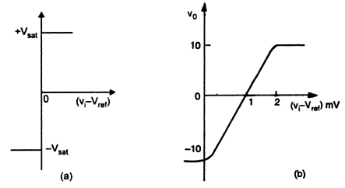
COMPARATORS
3

Slide 6
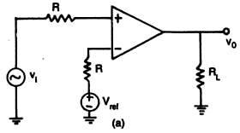
COMPARATORS
There are two types of comparators;
(i)Non-inverting comparator
(ii)Inverting comparator
4

Slide 7
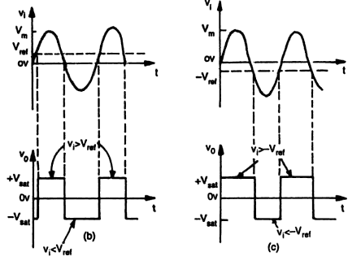
COMPARATORS
6

Slide 8
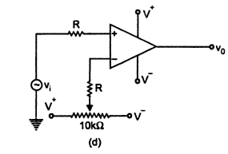
COMPARATORS
5

Slide 9
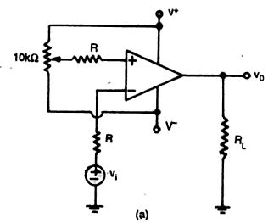
COMPARATORS
Inverting comparator
7

Slide 10
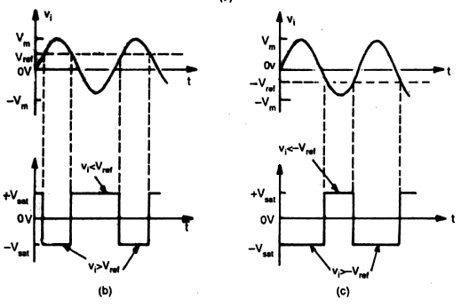
COMPARATORS
8

Slide 11
COMPARATORS
Some important applications of comparators;
(i)Zero cross detector
(ii)Window detector
(iii)Time marker generator
(iv)Phase detector
9

Slide 12
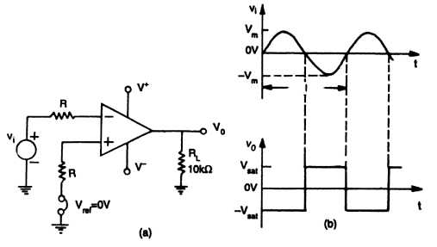
COMPARATORS
Zero cross detector
10

Slide 13
SCHMITT TRIGGER
14

Slide 14
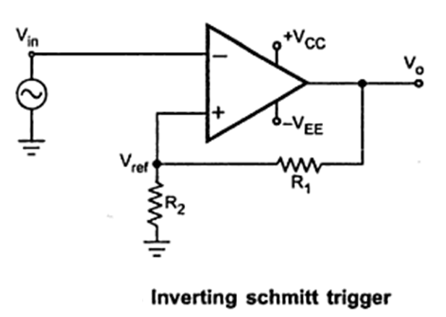
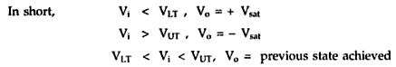
SCHMITT TRIGGER
15

Slide 15
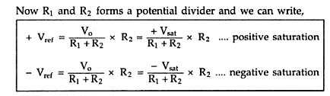
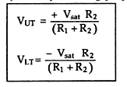
SCHMITT TRIGGER
16

Slide 16
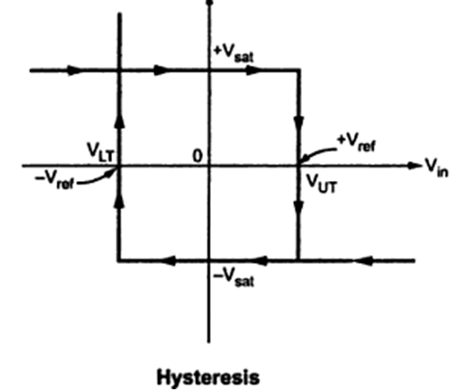
SCHMITT TRIGGER
17

Slide 17
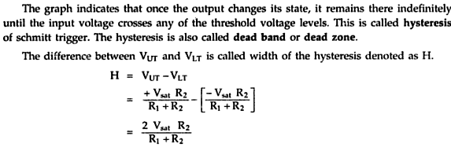
SCHMITT TRIGGER
18

Slide 18
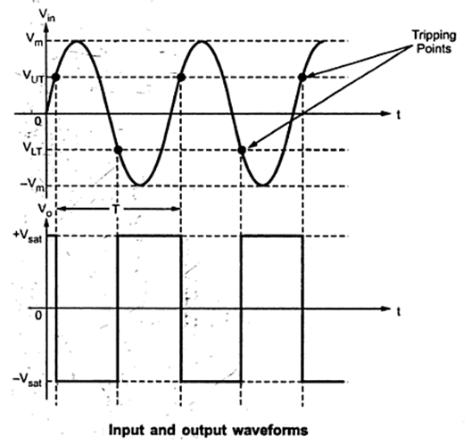
SCHMITT TRIGGER
19

Slide 19
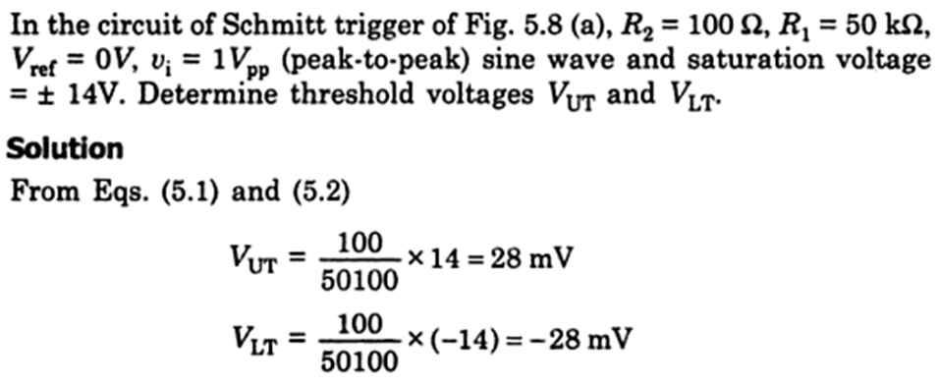
SCHMITT TRIGGER
20

Slide 20
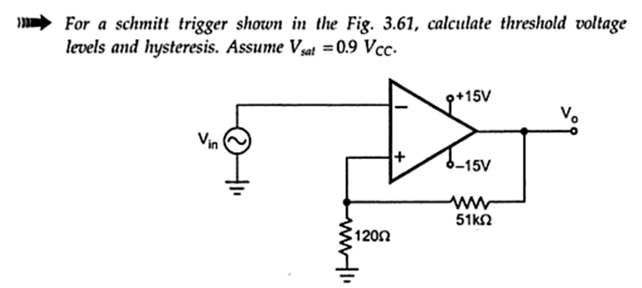
SCHMITT TRIGGER
21

Slide 21
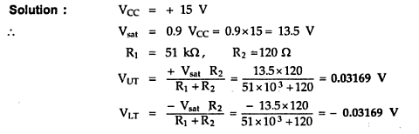
SCHMITT TRIGGER
22

Slide 22
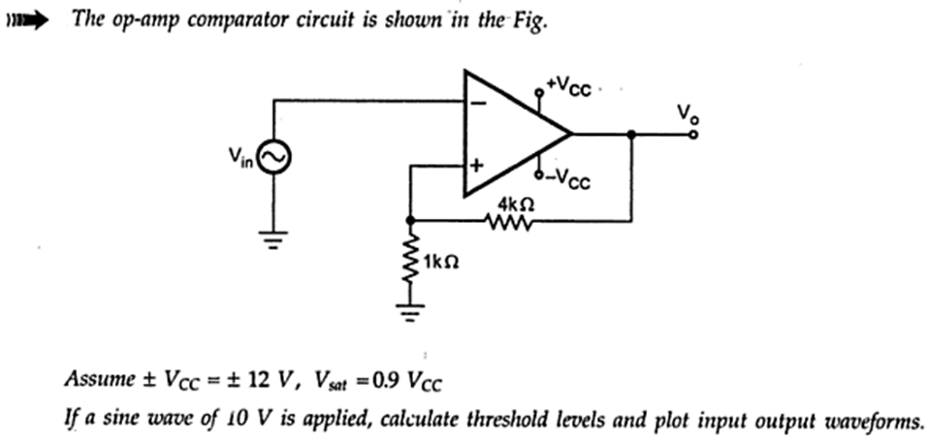
SCHMITT TRIGGER
23

Slide 23
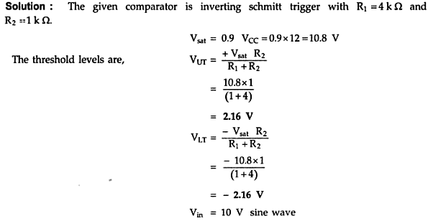
SCHMITT TRIGGER
24

Slide 24
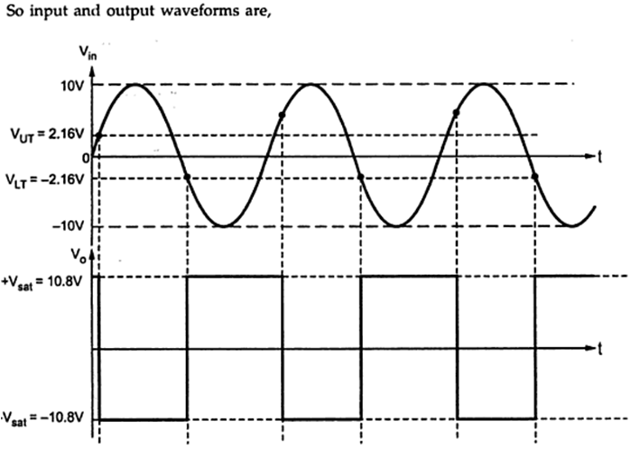
SCHMITT TRIGGER
25

Slide 25
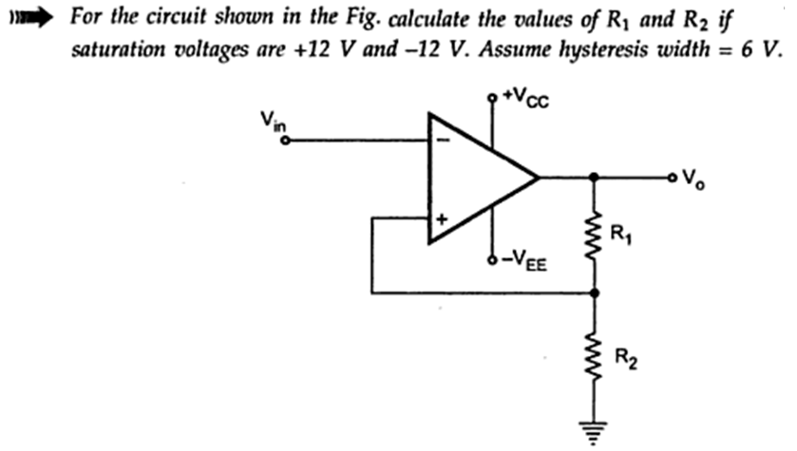
SCHMITT TRIGGER
26

Slide 26
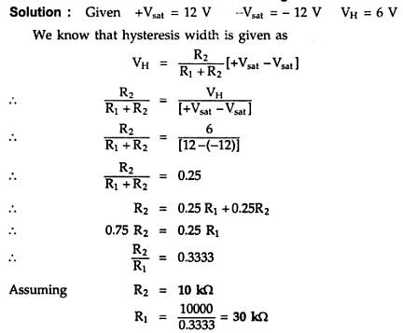
SCHMITT TRIGGER
27

Slide 27
FREE RUNNING OSCILLATOR
28

Slide 28
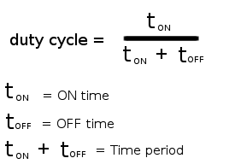
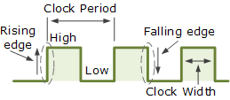
FREE RUNNING OSCILLATOR
MULTIVIBRATOR
A multivibrator is a circuit that oscillates between two states (“HIGH” and “LOW”) to produce a continuous output.
There are three types of multivibrator: astable (free-running), monostable (one-shot), and bistable (flip-flop). There are many ways of implementing each type, and many variants.
29

Slide 29
FREE RUNNING OSCILLATOR
MULTIVIBRATOR TYPES
Astable – A free-running multivibrator that has NO stable states but switches continuously between two states this action produces a train of square wave pulses at a fixed frequency.
Monostable – A one-shot multivibrator that has only ONE stable state and is triggered externally with it returning back to its first stable state.
Bistable – A flip-flop that has TWO stable states that produces a single pulse either positive or negative in value.

Slide 30
FREE RUNNING OSCILLATOR
ASTABLE MULTIVIBRATOR
Op-amps with positive feedback can be made to operate as multivibrators. In the op-amp multivibrator circuit the op-amp works as an analogue comparator.
An op-amp comparator compares the voltages on its two inputs and gives a positive or negative output depending on whether the input is greater or less than some reference value Vref.
The Op-amp Multivibrator is an astable oscillator circuit that generates a rectangular output waveform using an RC timing network connected to the inverting input of the operational amplifier and a voltage divider network connected to the other non-inverting input.

Slide 31
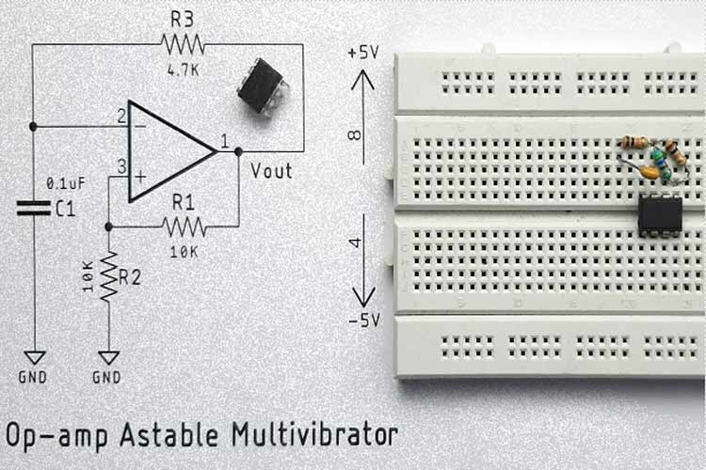

Slide 32
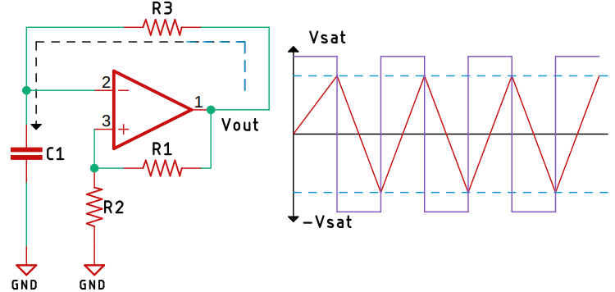
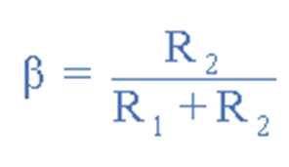

Slide 33
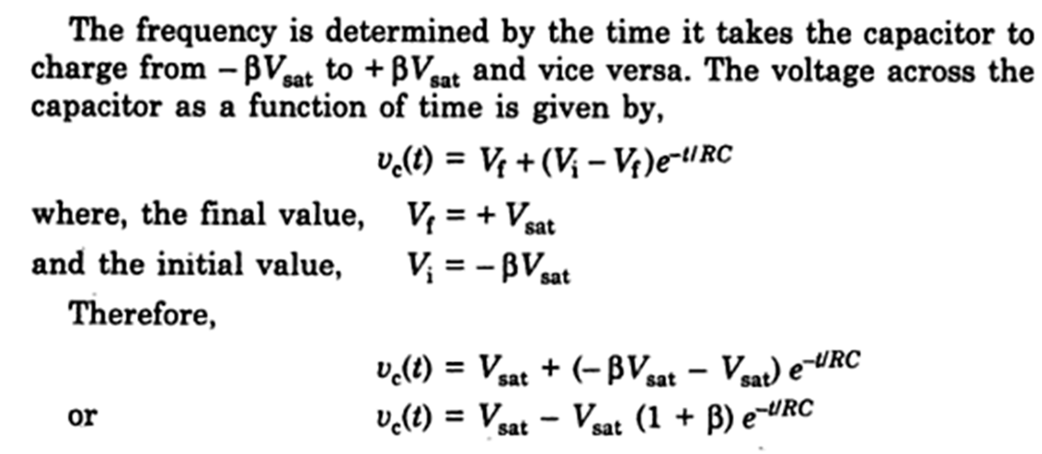

Slide 34
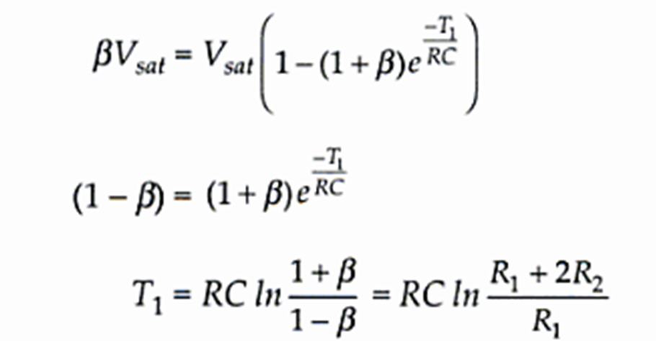
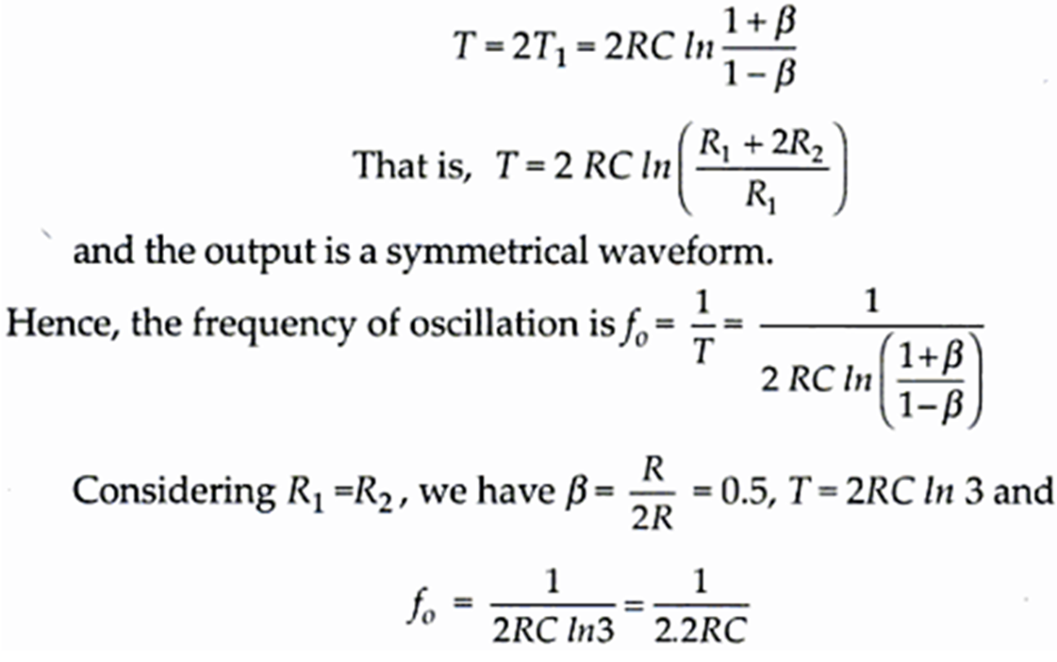

Slide 35
FREE RUNNING OSCILLATOR
ASTABLE MULTIVIBRATOR
The astable multivibrator using an op amp comprises two main sections.
(i). Feedback:
(ii). Hysteresis:
Feedback: This section of the amplifier provides frequency dependent feedback and controls the rate at which the capacitor charges and discharges.
It plays a major pert in determining the frequency of operation. It is governed by the capacitor C1 and the resistor R1. It is applied to the negative input terminal of the op amp.
33

Slide 36
FREE RUNNING OSCILLATOR
ASTABLE MULTIVIBRATOR
Hysteresis: The hysteresis section of the astable multivibrator is formed by the resistors R2 and R1.
These resistors effectively form a Schmitt trigger and enable the circuit to switch between the two states at different voltages for the positive going and negative going voltages on the inverting input.
The switch voltages determined by the resistors determine also have an effect on the frequency because it takes less time for C1 to charge to a lower voltage for switching than a larger one.
ECE204 – Analog Circuit Design
34

Slide 37
FREE RUNNING OSCILLATOR
ASTABLE MULTIVIBRATOR
Assume that the capacitor is fully discharged and the output of the op-amp is saturated at the positive supply rail. The capacitor, C starts to charge up from the output voltage, Vout through resistor, R at a rate determined by their RC time constant.
However, as soon as the capacitors charging voltage at the op-amps inverting (-) terminal is equal to or greater than the voltage at the non-inverting terminal (the op-amps output voltage fraction divided between resistors R1 and R2), the output will change state and be driven to the opposing negative supply rail.
ECE204 – Analog Circuit Design
35

Slide 38
FREE RUNNING OSCILLATOR
ASTABLE MULTIVIBRATOR
But the capacitor, which has been happily charging towards the positive supply rail (+V(sat)), now sees a negative voltage, -V(sat) across its plates.
This sudden reversal of the output voltage causes the capacitor to discharge toward the new value of Vout at a rate dictated again by their RC time constant.
Once the op-amps inverting terminal reaches the new negative reference voltage, -Vref at the non-inverting terminal, the op-amp once again changes state and the output is driven to the opposing supply rail voltage, +V(sat).
ECE204 – Analog Circuit Design
36

Slide 39
FREE RUNNING OSCILLATOR
APPLICATIONS
As a result of their simplicity, astable multivibrators find applications in a variety of different applications where square waves or timed intervals are required.
They have been used in frequency dividers as it is possible to lock them to a frequency lower than a reference frequency.
This principle was used in many items of electronic equipment from televisions where the line and frame oscillators were able to synchronize to pulses in the video signal.
ECE204 – Analog Circuit Design
44

Slide 40
FREE RUNNING OSCILLATOR
EXAMPLE-1
An op-amp multivibrator is constructed using the following components. R1 = 35kΩ,R2 = 30kΩ, R = 50kΩ and C = 0.01uF. Calculate the circuits frequency of oscillation.
ECE204 – Analog Circuit Design
45

Slide 41
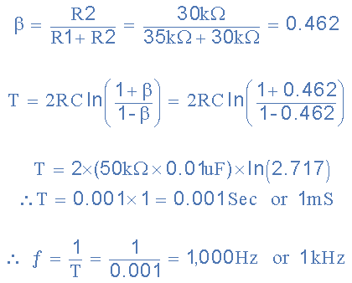
FREE RUNNING OSCILLATOR

Slide 42
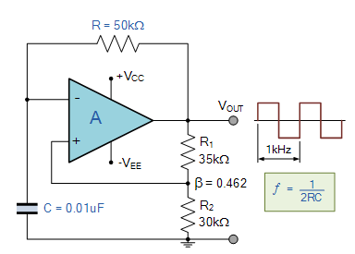
FREE RUNNING OSCILLATOR
EXAMPLE-1
ECE204 – Analog Circuit Design
46

Slide 43
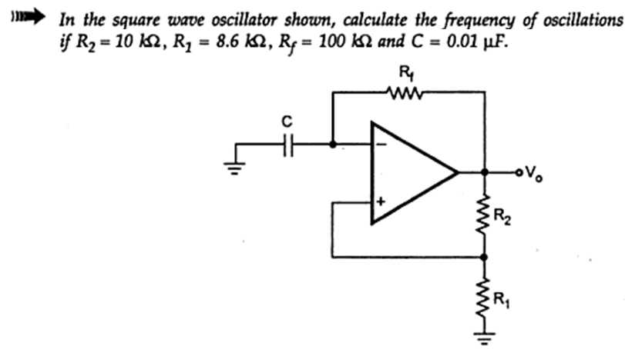
FREE RUNNING OSCILLATOR
ECE204 – Analog Circuit Design
47

Slide 44
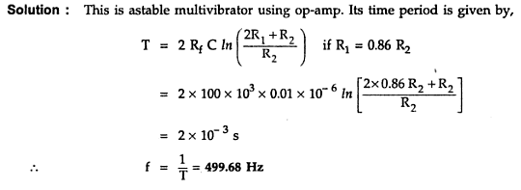
FREE RUNNING OSCILLATOR
ECE204 – Analog Circuit Design
48

Slide 45
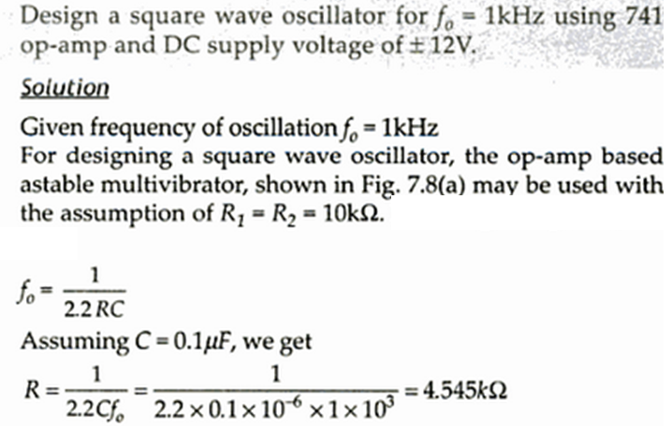
FREE RUNNING OSCILLATOR
ECE204 – Analog Circuit Design
49

Slide 46
ONE-SHOT MULTIVIBRATOR
50

Slide 47
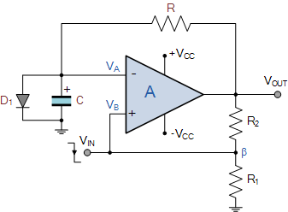
ONE SHOT MULTIVIBRATOR
Monostable multivibrator
ECE204 – Analog Circuit Design
51

Slide 48
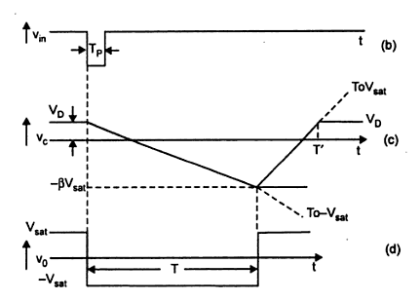
ONE SHOT MULTIVIBRATOR
Monostable multivibrator
ECE204 – Analog Circuit Design
52

Slide 49
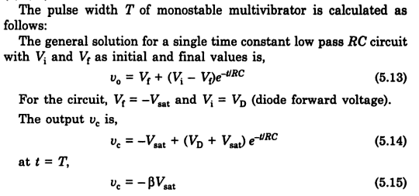
ONE SHOT MULTIVIBRATOR
Monostable multivibrator
ECE204 – Analog Circuit Design
53

Slide 50
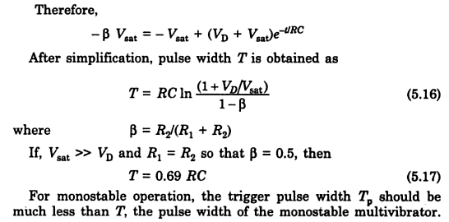
ONE SHOT MULTIVIBRATOR
Monostable multivibrator
ECE204 – Analog Circuit Design
54

Slide 51
SINE WAVE GENERATORS
55

Slide 52
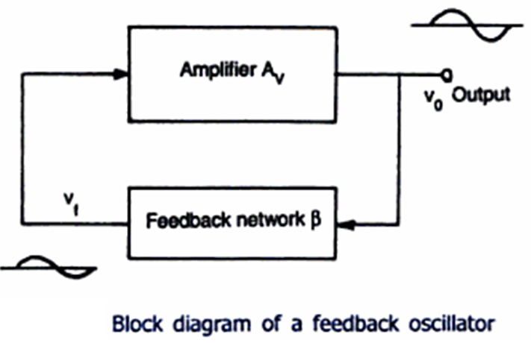
SINE WAVE GENERATOR
ECE204 – Analog Circuit Design
56

Slide 53
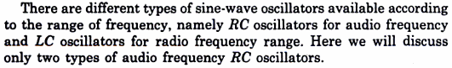
SINE WAVE GENERATOR TYPES
ECE204 – Analog Circuit Design
57

Slide 54
TRIANGULAR WAVE GENERATOR
87

Slide 55
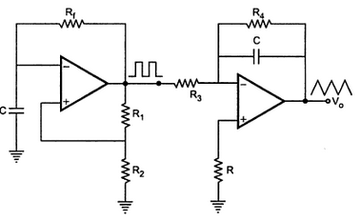
TRIANGULAR WAVE GENERATOR
ECE204 – Analog Circuit Design
88

Slide 56
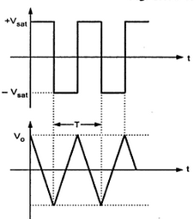
TRIANGULAR WAVE GENERATOR
V
T
Vo(pp)
t
ECE204 – Analog Circuit Design
89

Slide 57
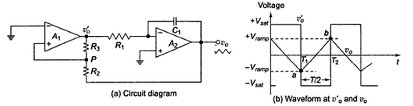
TRIANGULAR WAVE GENERATOR
ECE204 – Analog Circuit Design
90

Slide 58
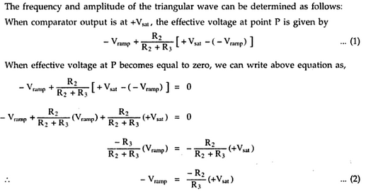
TRIANGULAR WAVE GENERATOR
ECE204 – Analog Circuit Design
91

Slide 59
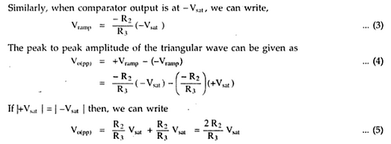
TRIANGULAR WAVE GENERATOR
ECE204 – Analog Circuit Design
92

Slide 60
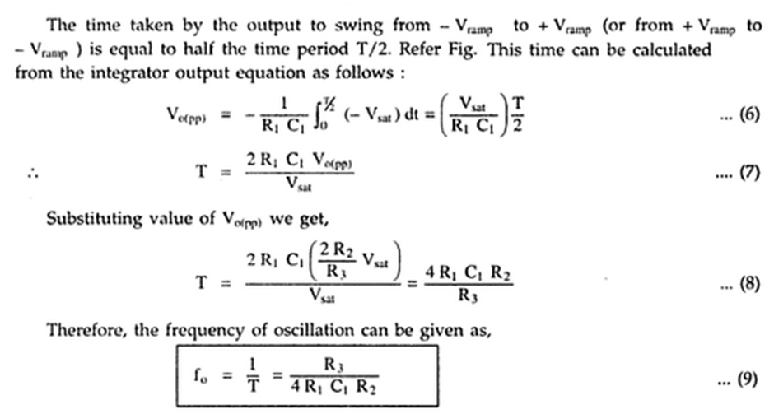
TRIANGULAR WAVE GENERATOR
ECE204 – Analog Circuit Design
93

Slide 61
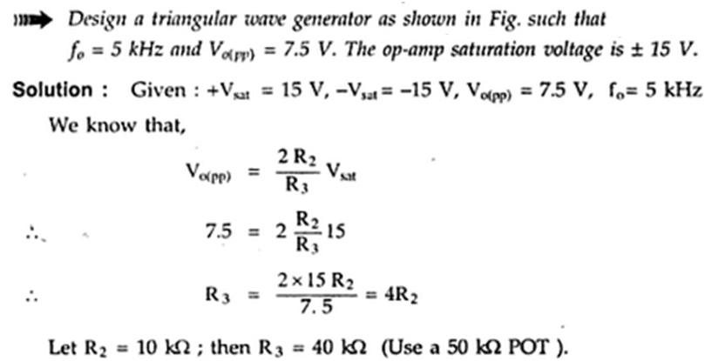

PROBLEMS
ECE204 – Analog Circuit Design
94

Slide 62
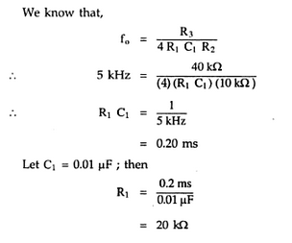
PROBLEMS
ECE204 – Analog Circuit Design
95

Slide 63
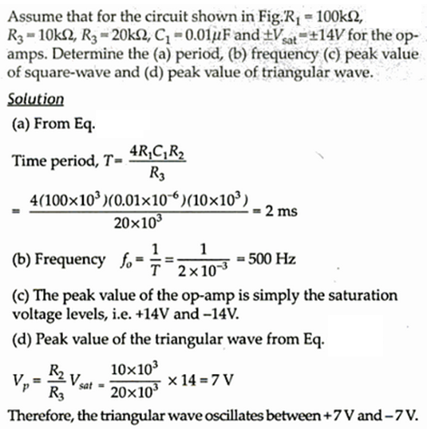
PROBLEMS
ECE204 – Analog Circuit Design
96

Slide 64
BARKHAUSEN CRITERION
58

Slide 65

BARKHAUSEN CRITERION
ECE204 – Analog Circuit Design
59

Slide 66
PHASE SHIFT OSCILLATOR
60

Slide 67

PHASE SHIFT OSCILLATOR
ECE204 – Analog Circuit Design
61

Slide 68

PHASE SHIFT OSCILLATOR
ECE204 – Analog Circuit Design
62

Slide 69

PHASE SHIFT OSCILLATOR
ECE204 – Analog Circuit Design
63

Slide 70


PHASE SHIFT OSCILLATOR
ECE204 – Analog Circuit Design
64

Slide 71

PHASE SHIFT OSCILLATOR
ECE204 – Analog Circuit Design
65

Slide 72

PHASE SHIFT OSCILLATOR
ECE204 – Analog Circuit Design
66

Slide 73

PHASE SHIFT OSCILLATOR
ECE204 – Analog Circuit Design
67

Slide 74


PHASE SHIFT OSCILLATOR
ECE204 – Analog Circuit Design
68

Slide 75

THANK YOU

